Slide 1
Bus Reservation System
IT 746: Database Systems
Anirudh Yerrapragada
Rahul Kakani
Venkat Vaddula
Sri Mounica Motipalli
Prof. Hossein Saiedian
Date: 12/7/2017
1

Slide 2
Organization
Introduction
ER Diagram
Mapping ER to Relational model
Tables and Functional Dependencies
Interesting query
Conclusion
2

Slide 3
Introduction:
Our Online bus reservation system is a web based application. It provides facility to book ticket, cancel ticket, check the bus schedule of a particular bus, check the booking history. Customer can book a ticket over the internet 24 hours a day, 7 days a week and the ticket can’t be lost or stolen. Our database maintains data of users details, bus details along with information about all the stops, reservation details and Passenger details
3

Slide 4
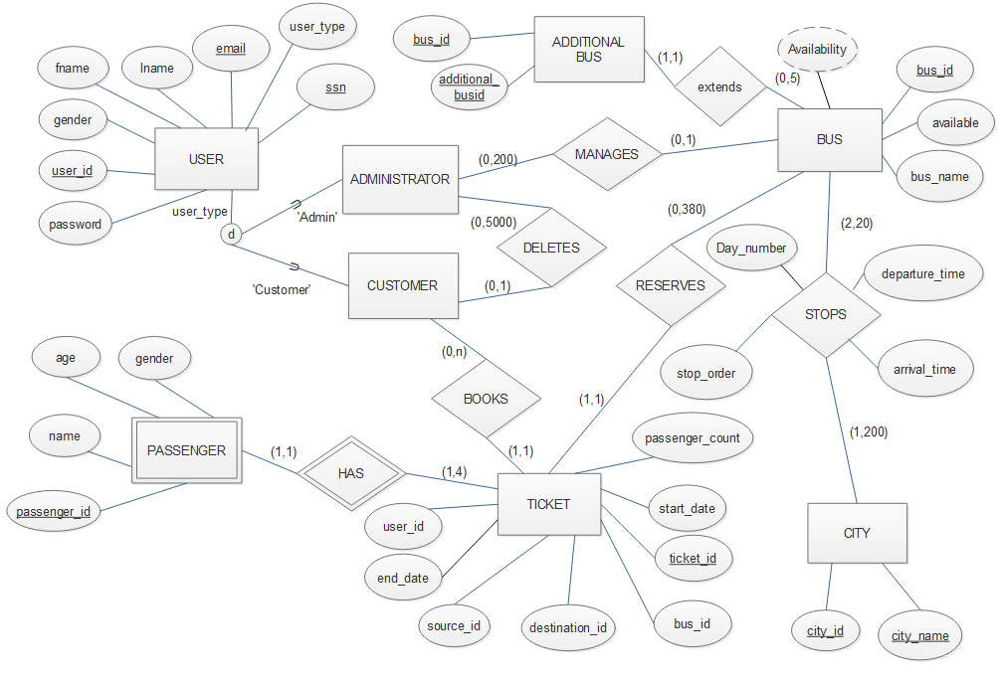
ER Diagram:
4

Slide 5
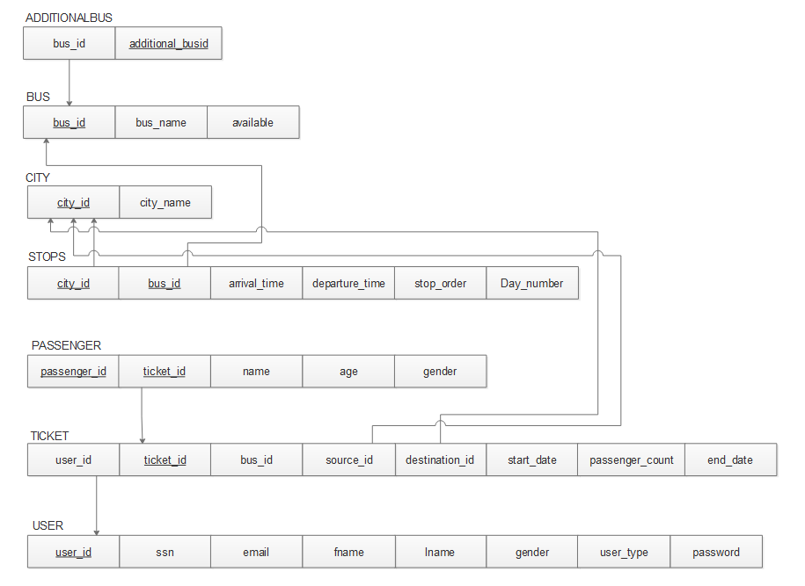
Mapping ER to relational model
5

Slide 6
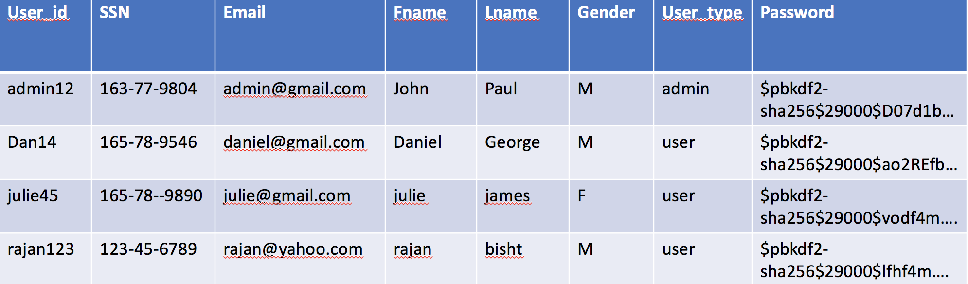
User Table
Key: User_Id
Normal Form: BCNF
6

Slide 7
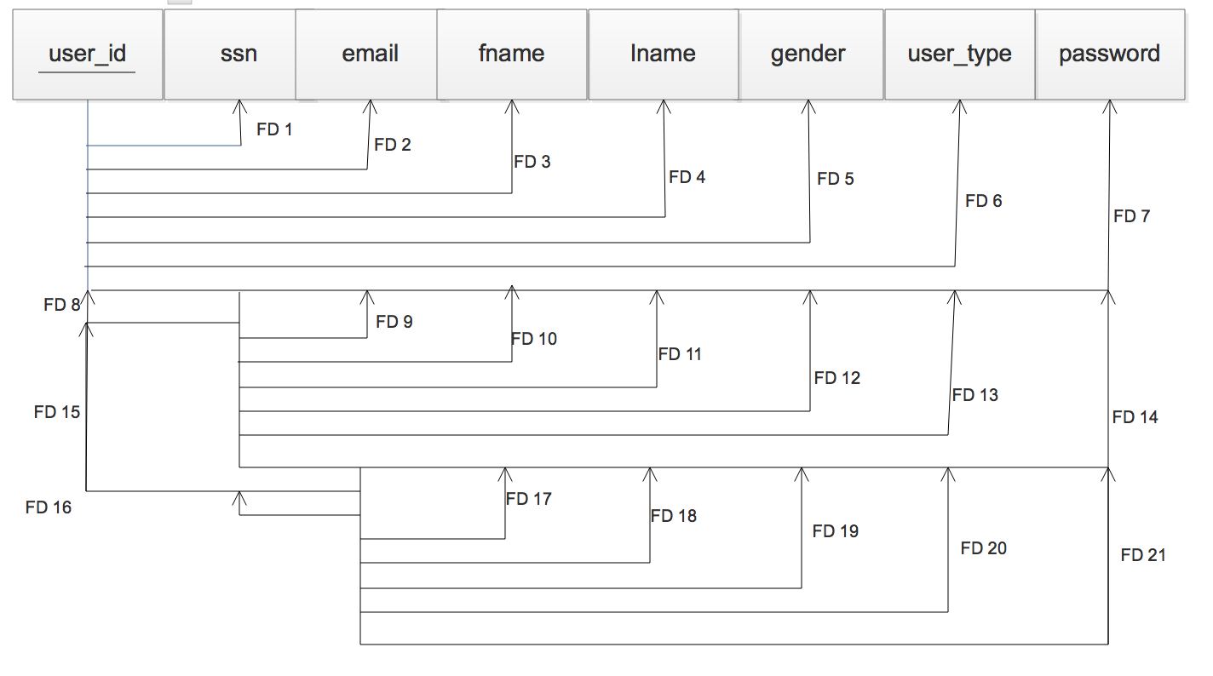
User table cont.
7

Slide 8
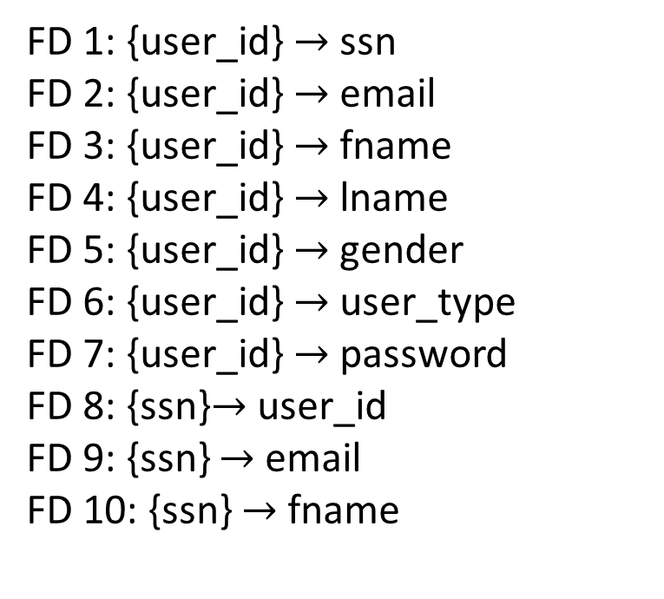
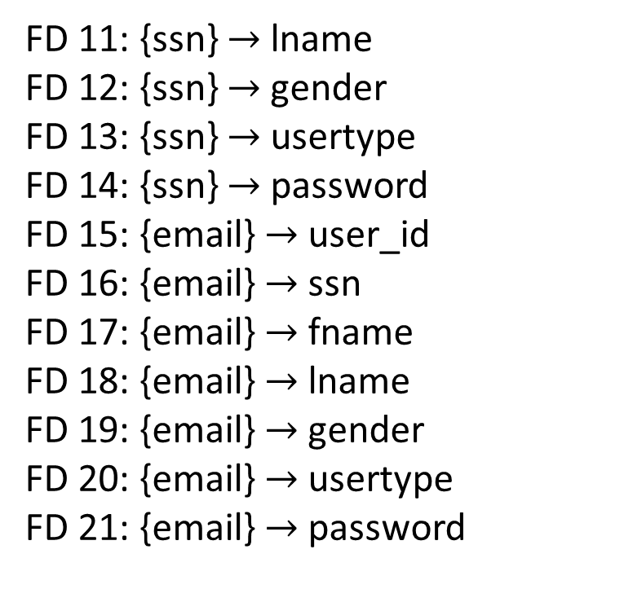
User table FD’s
FD 1: {user_id} $→$ssn
FD 2: {user_id}$→$ email
FD 3: {user_id}$→$ fname
FD 4: {user_id}$→$ lname
FD 5: {user_id}$→$ gender
FD 6: {user_id}$→$ user_type
FD 7: {user_id}$→$ password
FD 8: {ssn}$→$user_id
FD 9: {ssn} $→$email
FD 10: {ssn} $→$fname
FD 11: {ssn} $→$lname
FD 12: {ssn} $→$gender
FD 13: {ssn} $→$usertype
FD 14: {ssn} $→$password
FD 15: {email} $→$user_id
FD 16: {email} $→$ssn
FD 17: {email} $→$fname
FD 18: {email} $→$lname
FD 19: {email} $→$gender
FD 20: {email} $→$usertype
FD 21: {email} $→$password
8

Slide 9
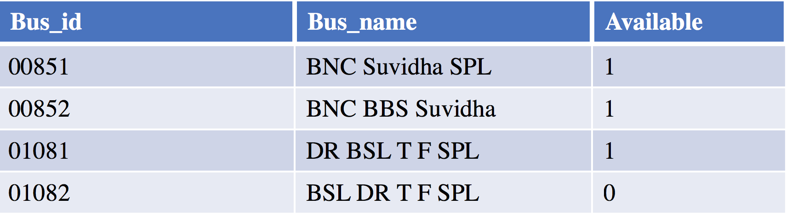
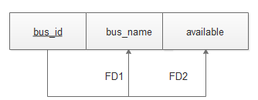

Bus table
Key: Bus_id
Normal Form: BCNF
FD1 : bus_id $→$ bus_name
FD2 : bus_id $→$ available
9

Slide 10
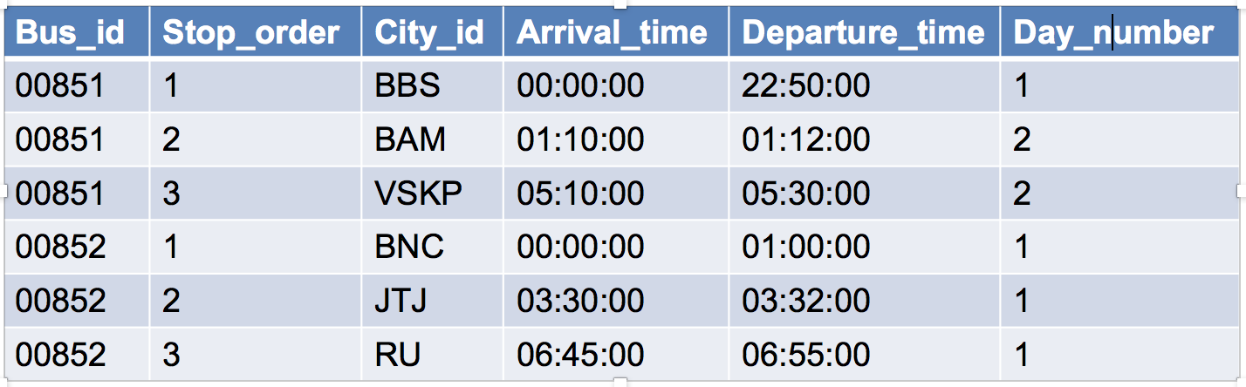
Stops table
Key: {city_id, bus_id}
Normal Form: BCNF
Key: {Bus_id, City_id}
Normal Form: BCNF
10

Slide 11
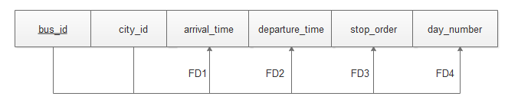
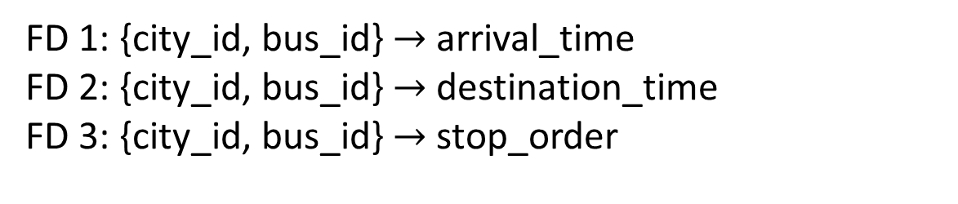
Stops table FDs
FD 1: {city_id, bus_id} $→$arrival_time
FD 2: {city_id, bus_id} $→$destination_time
FD 3: {city_id, bus_id} $→$ stop_order
11

Slide 12
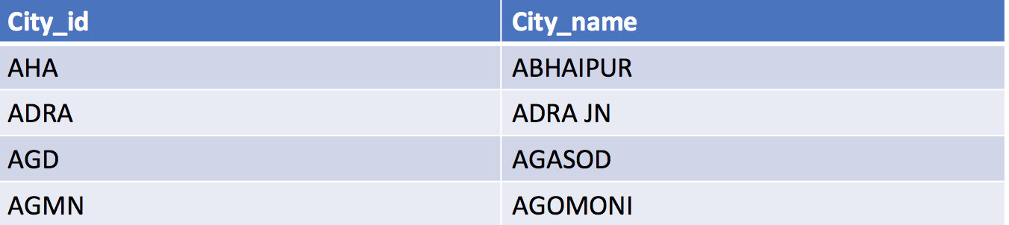
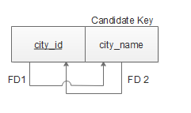

City Table:
Key: City_Id
Normal Form: BCNF
FD 1: city_id $→$city_name
FD 2: city_name $→$city_id
12

Slide 13
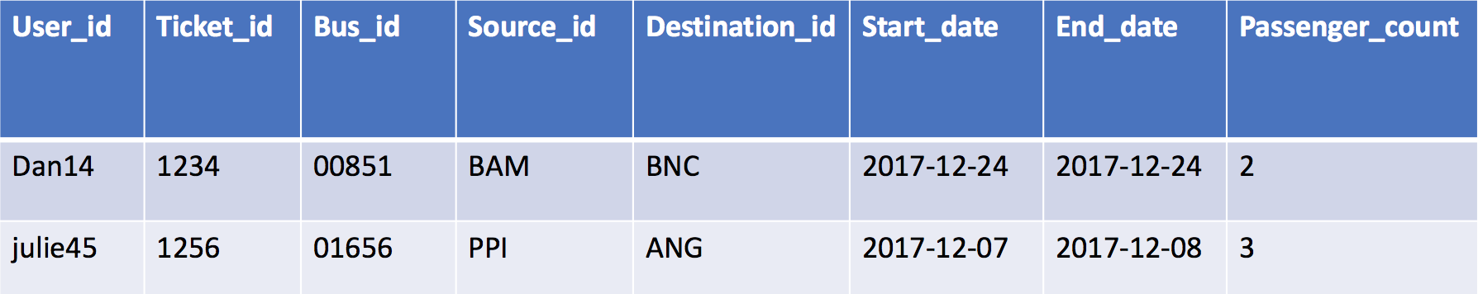
Ticket Table:
Key: Ticket_Id
Normal Form: BCNF
13

Slide 14
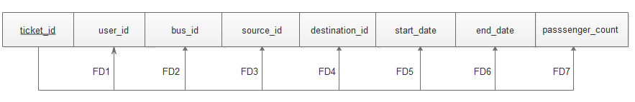
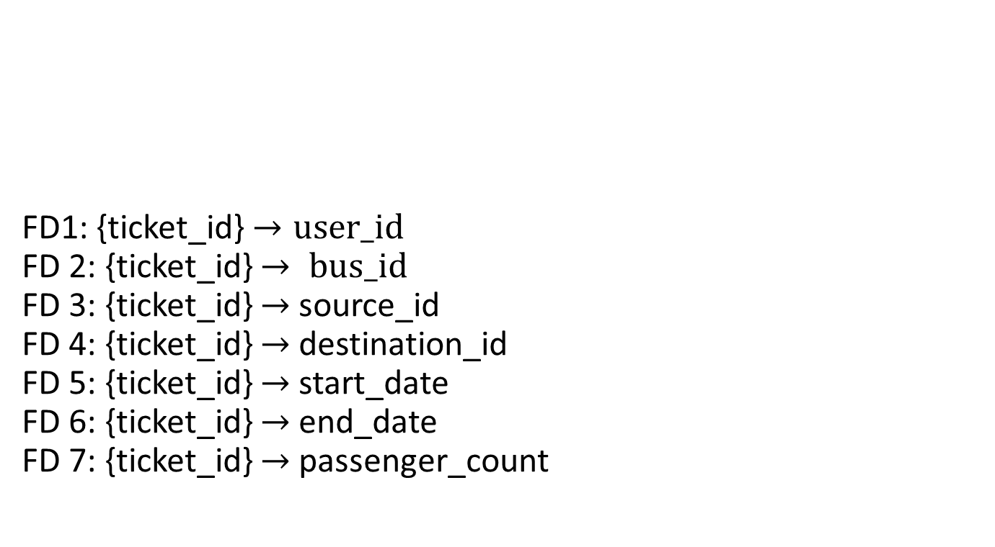
Ticket table cont.
FD1: {ticket_id} $→user_id$
FD 2: {ticket_id} $→ bus_id$
FD 3: {ticket_id} $→$source_id
FD 4: {ticket_id} $→$destination_id
FD 5: {ticket_id} $→$start_date
FD 6: {ticket_id} $→$end_date
FD 7: {ticket_id} $→$passenger_count
14

Slide 15
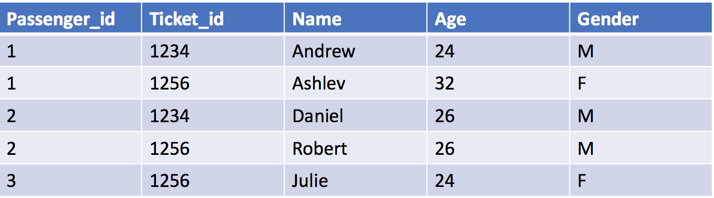
Passenger Table
Key: Passenger_id, Ticket_id
Normal Form: BCNF
15

Slide 16
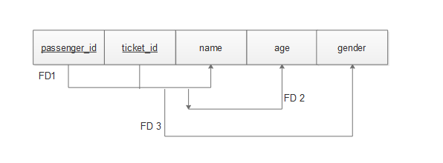
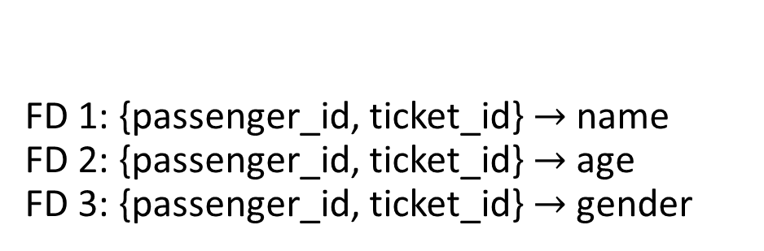
Passenger table cont.
FD 1: {passenger_id, ticket_id} $→$name
FD 2: {passenger_id, ticket_id}$→$age
FD 3: {passenger_id, ticket_id} $→$gender
16

Slide 17
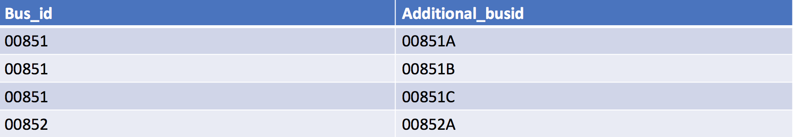
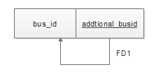
Additional Bus
Key: Bus_Id
Normal Form: BCNF
17

Slide 18
Interesting Query : Book a Ticket
This query can be divided into 3 steps
Find available buses between selected source and Destination.
Retrieve all the necessary information from the TICKET and STOPS tables to calculate availability.
JOIN the results of step a and b.
18

Slide 19

a. Find available buses
For Example, selected Source is Hyderabad(HYB) and Destination is Secunderabad (SC).
Find all the buses visiting the selected Source (Hyderabad) from STOPS table.
19

Slide 20
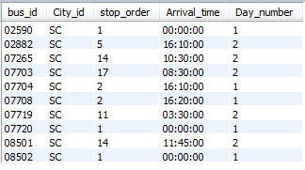
a. Find available buses cont.
Find all the buses visiting the selected destination (Secunderabad) from STOPS table.
20

Slide 21
a. Find available buses cont.
Condition:
Source.bus_id = Destination.bus_id
AND Source.stop_order < Destination.stop_order
JOIN the above result with CITY and BUS tables to retrieve Bus name, Source and Destination names
21

Slide 22
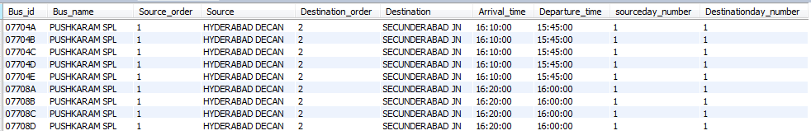
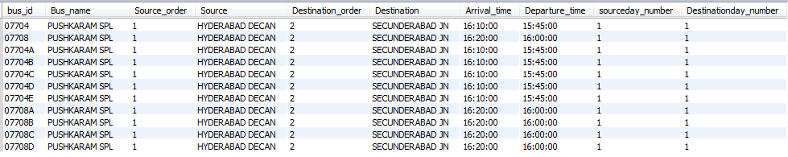
a. Find available buses cont.
Find all the duplicate buses for the available buses using the ADDITIONALBUS table
Total available buses:
22

Slide 23
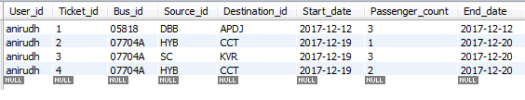
b. Booked Ticket Information
Data stored in TICKET table
Retrieve the required information from STOPS and CITY table
23

Slide 24
Final Step
Result 1 (Total available buses)
Result 2 (Booked ticket information)
24

Slide 25
Final Step cont.
Time stamps
Booked ticket timestamps:
Tkt_start = concat(booked_tkt.start_date ,' ',booked_tkt.source_time)
Tkt_end = concat(booked_tkt.end_date,' ', booked_tkt.destination_time)
Bus expected timestamps:
Bus_start = concat(date'2017-12-19',' ',avail_bus.departure_time)
Bus_end = concat(date(DATE'2017-12-19'+((avail_bus.Destinationday_number-avail_bus.sourceday_number))),' ',avail_bus.arrival_time)
25

Slide 26
Final Step cont.
Result1 LEFT OUTER JOIN Result2 on
(
Result1.bus_id = Result2.bus_id
AND
(
((Bus_start <= Tkt_start) AND (Tkt_start < Bus_end))
OR
((Bus_start< Tkt_end) AND (TKt_end <= Bus_end))
)
)
26

Slide 27
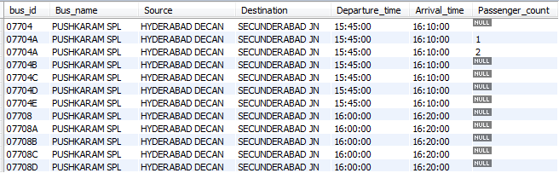
Final Step cont.
Result:
27

Slide 28
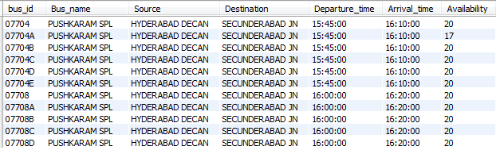
Final Result
Group by Bus_id and
Availability = 20 - sum(Passenger_count)
28

Slide 29
Conclusion
Our Bus Reservation System is an online system which enables customers to check availability of buses from source to destination, book or cancel tickets and check Bus schedule. It makes the customer easy to get bus ticket online instead of queue up to buy the bus ticket.
29

Slide 30
Future Scope
Improve in a way such that multiple-users can access and utilize the web application simultaneously.
Improving the web application in way such that it allows user to travel through connecting buses and reach several other new destinations.
Online payment can be implemented.
Waiting list on the available buses can be provided.
Allow user to reserve more than 4 passengers per ticket.
30

Slide 31
References
Elmasri, R. & Navathe, S., 2017. Fundamentals of database systems, Boston: Pearson.
HTML5 Tutorial. HTML Tutorial. Available at: https://www.w3schools.com/html/default.asp
Documentation. Django documentation | Django documentation | Django. Available at: https://docs.djangoproject.com/en/2.0/.
31

